Slide 1
Team Burgundy
Show and tell
23rd June 2015

Slide 2
Definition of the minimal viable product
“the smallest thing you can build that delivers customer value”

Slide 3
User Stories
User Story 1 – news in context of the User’s location
customer is on holiday and arrives in a new location. They go to our website and are presented with location based stories
User Story 2 – news for another location
a user from Cork is working in Dublin and wants to keep in touch with events at home

Slide 4
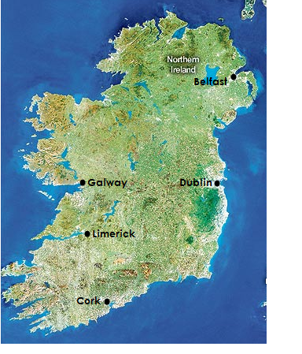
Our minimal viable product
The product will have:
Web landing page –pins denoting location
News and events close to the geolocation
News articles are from one news site – www.rte.ie

Slide 5
Technology Stack
API
Tweepy
OpenLayers
Newspaper
Programming Languages
Python
Javascript
CSS
HTML5
Web framework
Django
Database
Postgresql

Slide 6
What we hope to learn from MVP?
Design core functions of the product
Connect geolocation to relevant news stories
Highlight methodological difficulties

